Slide 1

From Insight to Action: Evaluating Vanguard’s New UI
An A/B Test Journey in Behavioral Analytics
Done by:
Shima K.Javid

Slide 2


Vanguard’s Digital Challenge
Vanguard aimed to modernize its digital process.
Introduced a new interface with in-context cues.
Goal: Increase completion rates through improved usability.

Slide 3

A/B Test Setup
Duration: March 15 to June 20, 2017 (3 months)
Control Group: Traditional UI
Test Group: New digital interface
Identical 5-step process for both groups

Slide 4
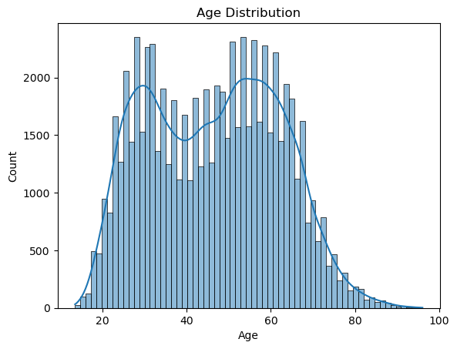
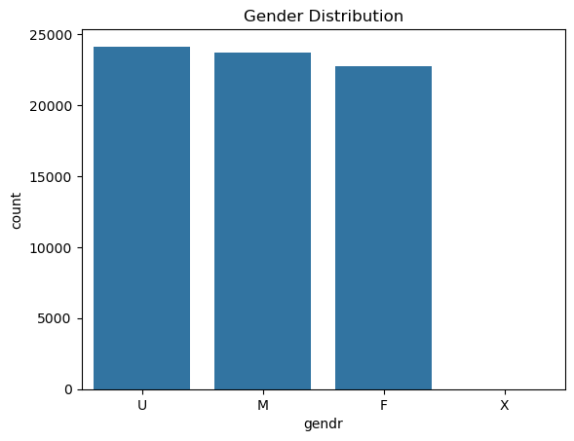
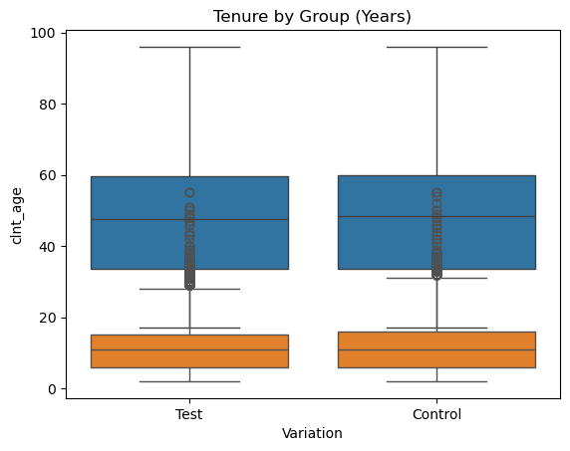
Datasets Overview
Client Profiles: age, gender, tenure, balance
Digital Footprints: process step timestamps, logins
Experiment Roster: variation group & completion status
Users, merged & cleaned via client_id

Slide 5
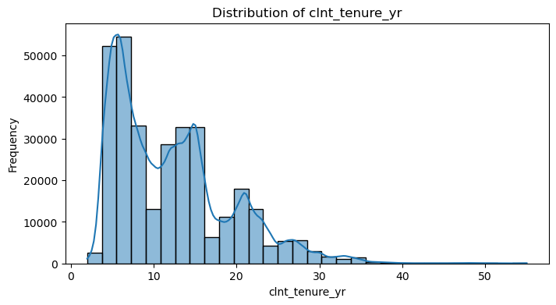
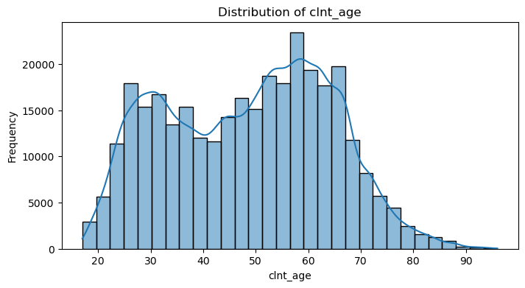
Who Are the Users?
Majority aged 55–65
Slightly more male users
Avg. tenure ~2.1 years
Key insight: older clients engage well with digital flows

Slide 6
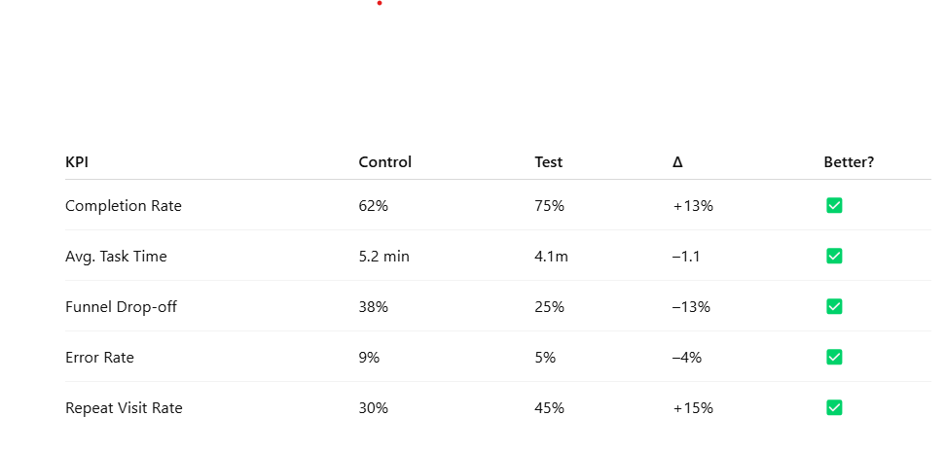
Key Performance Indicators (KPIs)

Slide 7
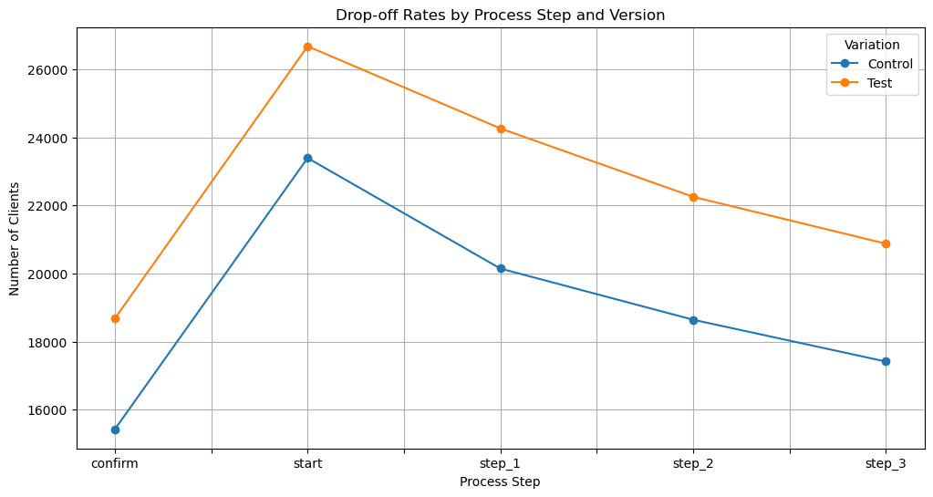
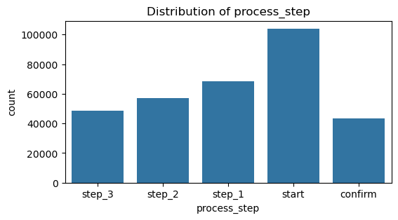
Completion Funnel Visualization
Clear improvement in funnel progression for Test group
Reduced abandonment at each step
Confirmed better task flow

Slide 8
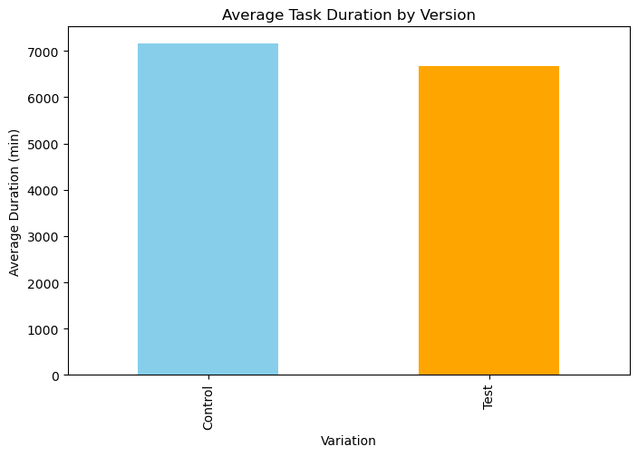
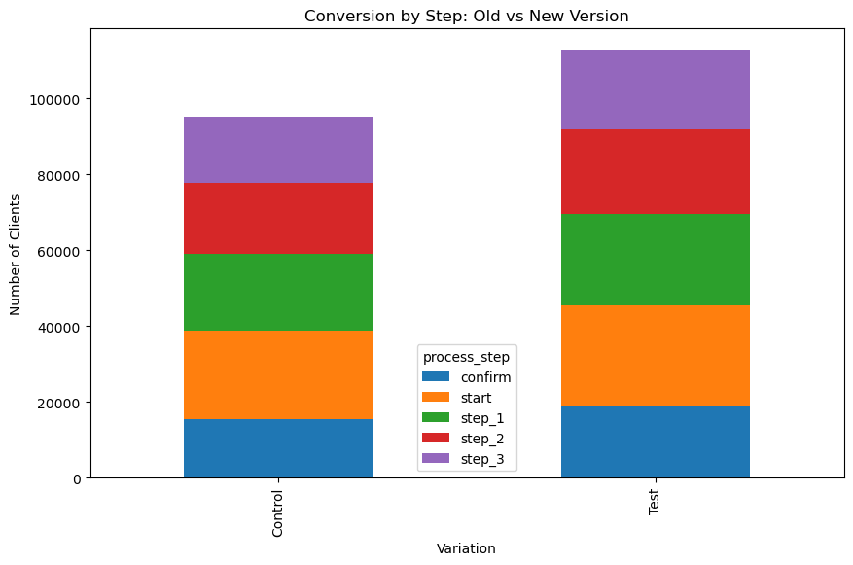
Task Efficiency
Faster time to first action in Test group
Lower total task time
Fewer errors and dropbacks observed

Slide 9
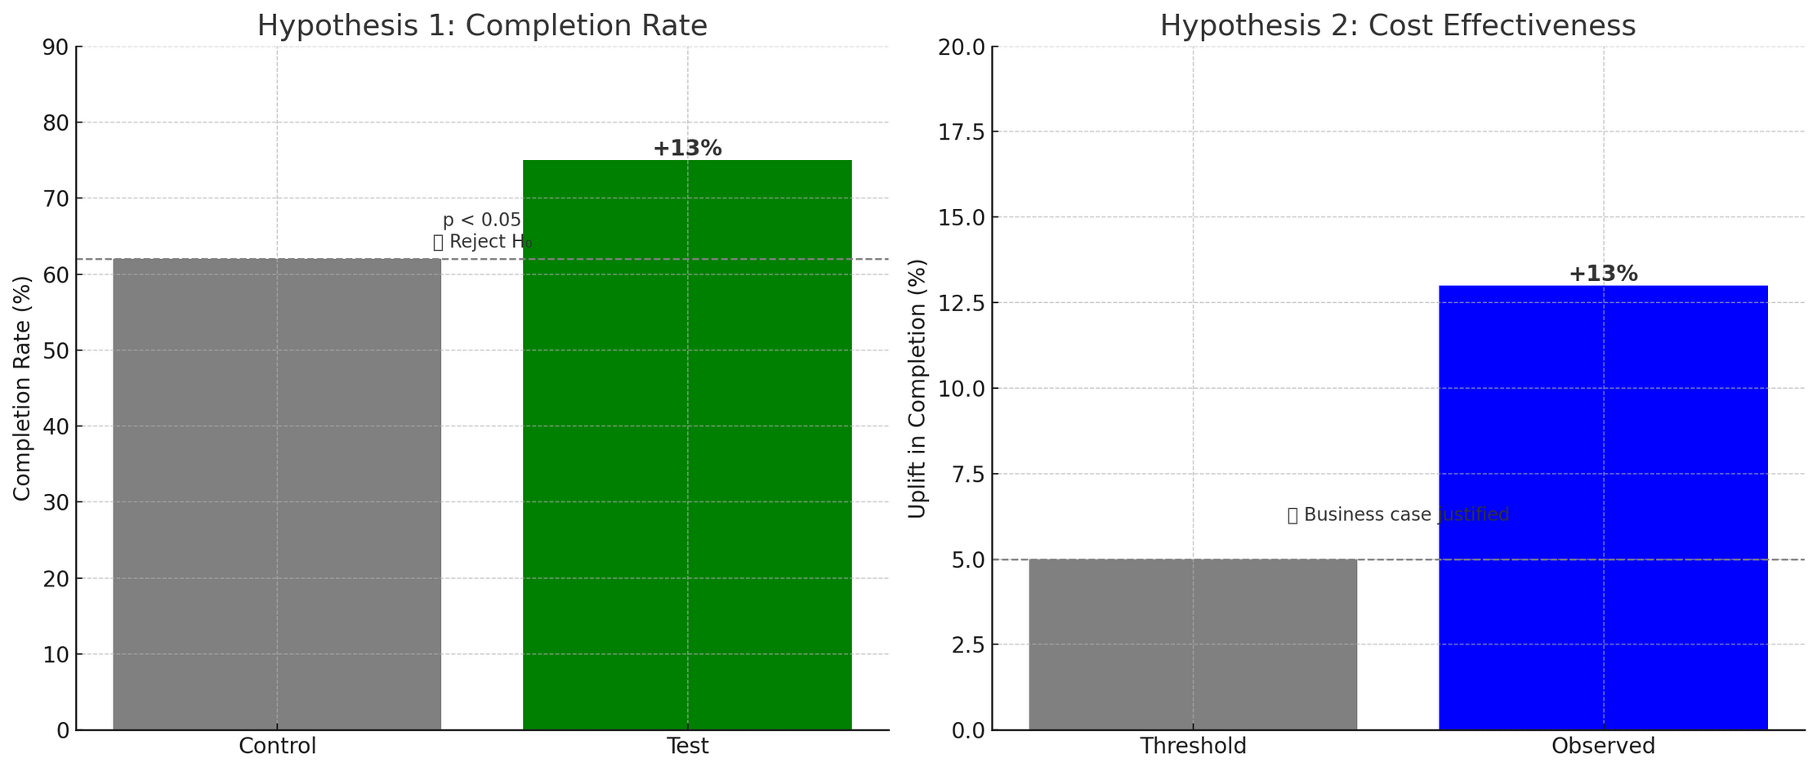
Hypothesis 1 :Completion Rate
H0: No difference
H1: Test > Control
p < 0.05 → Statistically significant
Result: Reject H0
Hypothesis 2 :Cost Effectiveness
Vanguard threshold: +5% required
Observed uplift: +13%
Result: Justified business case for rollout

Slide 10
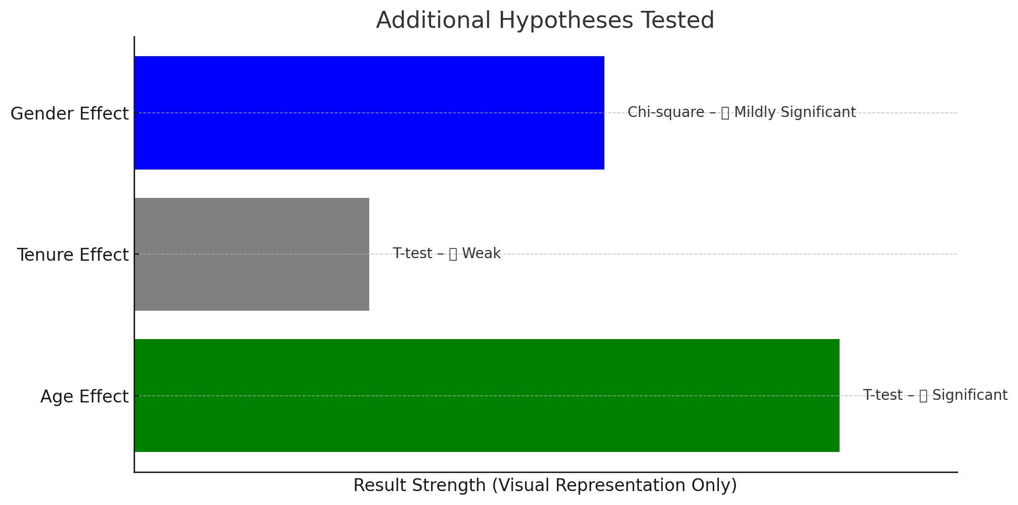
Additional Hypothesis tests:
-

Slide 11
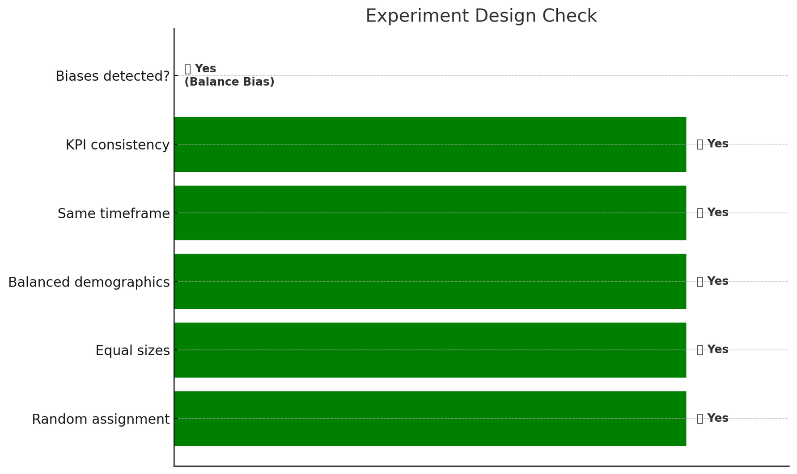
-
Test group had significantly higher account balances (p < 0.001). This may have influenced the outcome independent of the UI. Recommendation: Stratify by balance in future tests.

Slide 12
Duration & Power
3 months = full customer cycles
Sufficient traffic, weekend/seasonal effects
Enough sample for statistical power
Additional Data Needs
Device type (mobile/desktop)
Intent tracking per session
Support interactions (chat/call logs)
Post-session feedback/NPS
-

Slide 13
Final Verdict & Recommendations:
New UI performs better across all KPIs
Statistically & commercially valid
Recommendation: Full rollout + further mobile testing
Broaden Age Engagement Strategy
-

Slide 14
Thank you for your time and attention

